Slide 1

Studies on the applicability of the mechanical advantage
hypothesis of grasping
Banuvathy R
(AM15D011)
Research Advisor
Dr Varadhan SKM
Neuromechanics lab
Department of Applied Mechanics
Indian Institute of Technology Madras
Notes:
Good afternoon to one and all gathered. Am glad to invite u all for my synopsis meeting. My research topic is regarding the …

Slide 2
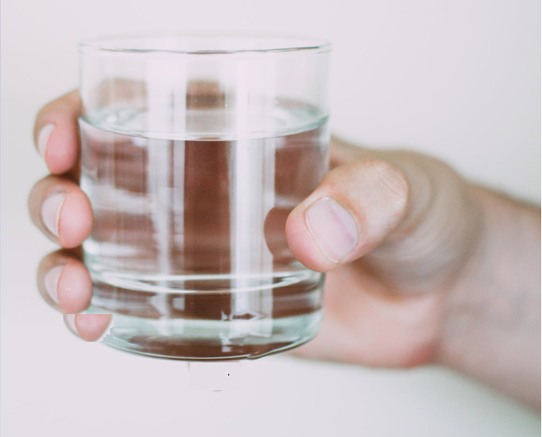
Introduction
Virtual finger LF
Thumb LF
Index GF
Middle GF
Thumb GF
Ring GF
Little GF
GF- Grip force
LF- Load force
Weight of the object
Notes:
To start with, let me give a brief introduction about my research topic. We all know that our hand is a unique tool that serves us in a multitude of ways. Many of our daily activities like lifting a cup or holding a mug demand the use of our hand.
In this picture, we could see a person holding a glass of water. Fine adjustment of the fingertip forces is essential for maintaining the grasp stable. That is to avoid spillage of water from hand.
Grip force and the load force are the two important fingertip forces to keep the object stable. Grip force is a normal force acting perpendicular to the surface of the object .Load force is a tangential force acting parallel to the surface of the handle to balance the wt of object. Applied GF shouldn’t be too high to crush th object or too low to cause slipping. Appropriate amount of GF to be produced by all digits while grasping.

Slide 3
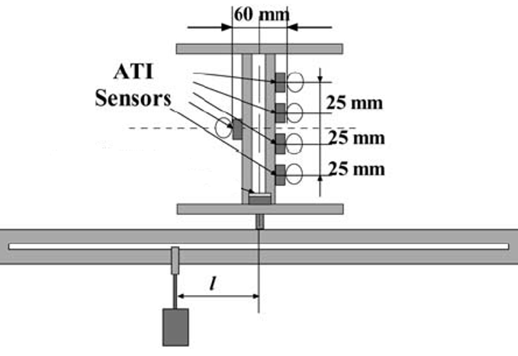
Literature
Zatsiorsky et.al (2002)
Mechanical Advantage hypothesis
During moment production task, peripheral fingers (Index and little) with longer moment arm for normal force produce greater normal force than the central fingers (middle and ring) with shorter moment arms
-
I
External load
M
T
+
‘+ ve’= pronation (or anticlockwise) torque
‘- ve’= supination (or clockwise) torque
R
L
Notes:
It was always a question from the past, how Object stabilization is achieved and what strategy our central nervous syst employs to achieve stabilization, when there are systematic variations or perturbation introduced to the grasped object.. In this zatsiorsky study, torque changes were introduced by suspending external load at a distance from center of mass of the handle. Due to load suspension, there occurs a pronation torque in the anti-clk direction. However the instruction was to maintain the handle in static equilibrium.
To re-establish the equilibrium, compensatory supination moment was required. Acco to MAH, during moment produ tasks, Index and little fingers with longer moment arm for normal force produce greater normal force than the middle and ring fingers with shorter moment arms.

Slide 4
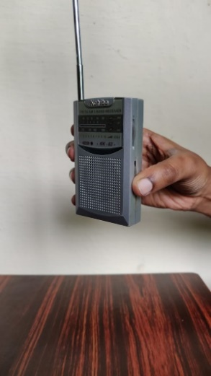
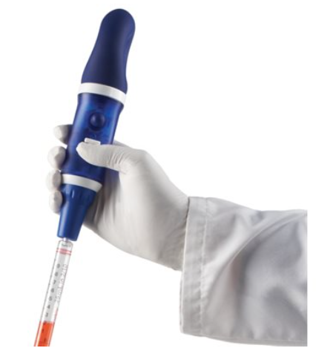
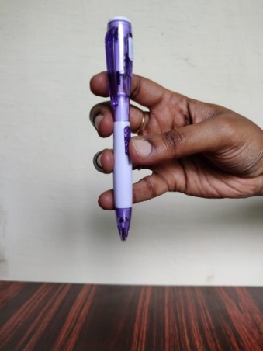
Motivation for the current research
Pocket radio
Image source: https://www.heathrowscientific.com/pipette-controller-i-120479
Retractable ball point pen
Pipette controller
How object stabilization is achieved while holding a handle that consists of unsteady thumb base?
Notes:
Motivation for the current study is that there are certain objects in real life like hand held pocket radio, Retractable ball point pens and pipette controllers that consists of slider on the thumb side for the fine adjustment of its functionality. The current research was inspired by observing such objects. This triggered to question on how object stabilization would be attained while holding a handle when the thumb is placed on a slider or an unsteady base.

Slide 5
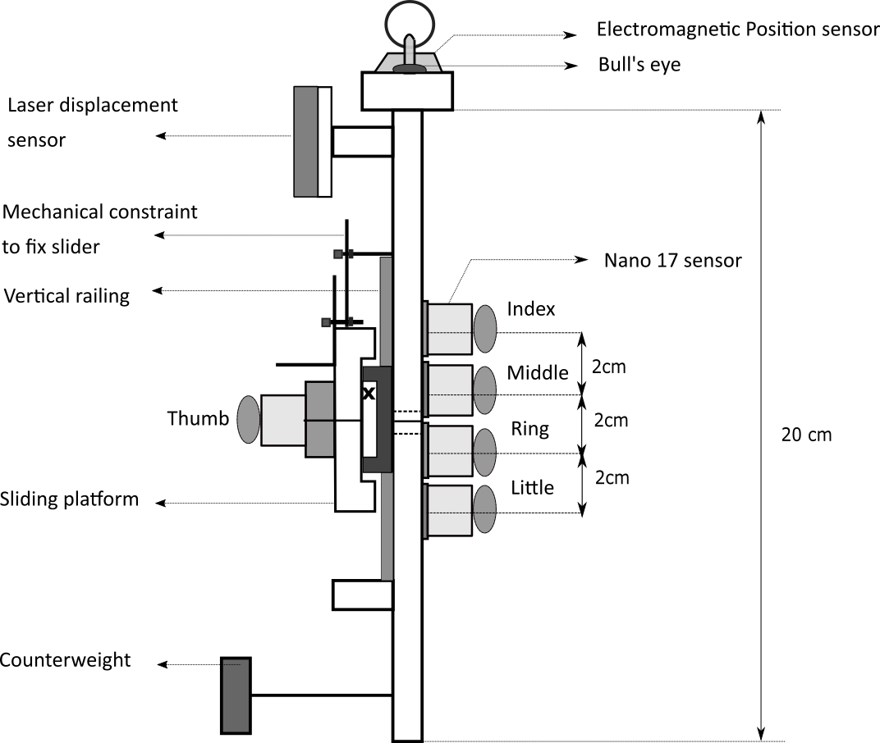
Experimental handle with slider platform
T
Index
Middle
(Force sensor)
HOME position
Ring
Little
Total mass of the handle (including slider platform) =0.535kg
T= Thumb
Notes:
Thus a handle with slider platform was designed. By this way, The friction between the platform and handle frame is reduced. This will in turn casue torque changes to the handle. Total mass of the handle including the slider platform is 535gms. On the thumb side of the handle frame, a vertical railing was fitted to mount the slider platform. A mechanical constraint was used to fix the position of the slider at the HOME position (that s found midway between middl and ring fingers). In the absence of mechanical constraint, slider could translate in the vertical direction over the railing like this. Five 6axis force/torque sensors were mounted to measure the fingertip forces of individual fingers and thumb. Force sensor for thumb was placed on the slider platform. A laser displ sensor was placed on top of the handle toward the thumb side to measure the position of the slider platform. An acrylic block was attached on top in the anterior posterior direction to mount electromagnetic tracking sensor and bull’s eye. Bull’s eye provide tilt fb to the participant.

Slide 6
Objectives
To study how the fingertip forces re-distribute for establishing object stabilization when the thumb was placed on an unsteady platform. The force distribution was studied in the presence and absence of mechanical constraint to fix the unsteady thumb platform while grasping. In particular, the contribution of ulnar fingers in maintaining the static equilibrium was explored.
To examine whether the applicability of the Mechanical advantage hypothesis is task-specific and to investigate the kind of task that lends support to the hypothesis. This was done by systematically increasing the mass of the handle by suspending external loads of varying masses below the center of mass of the handle.
To confirm on the kind of task that causes CNS to prefer the strategy of mechanical advantage principle by restricting the normal force of the thumb while holding the thumb platform steady at the HOME position.
To investigate the biomechanical relationship between the thumb and peripheral fingers when the unsteady thumb platform was translated in the vertical direction while grasping.
Notes:
These are four main objectives of the current research. Each objective was addressed by a separate experiment. So there will be 4 separate experiments performed to address the four different objectives.
The first object was to…..This objective was addressed by conducting a preliminary study that involves in understanding the role of ulnar finges ring and little fingers in establishing handle equil.
Next is , from literature it was known that the support for MAH is specific to any particular task and it was still a question on what kind of task that lend support to MAH. Therefore the second exp was conducted to examine the support for the hypothes is task specific in nature and to investigate on the kind of task that lends support to the hypothe.
The third objective was to confirm on the kind of task that triggers CNS in employinh strategy of MAH. This was addressed by conducting an experiment that involved in imposing restriction to produce minimal target normal force by the thumb while holding the thumb platform steady at the HOME position.
The fourth objective was to investigate on the biomechanical relationship that exists between the thumb and peripheral fingers when the unsteady thumb platform is translated in the vertical direction while grasping.

Slide 7
Experiment 1 (Preliminary study)
Will the Mechanical advantage hypothesis (MAH) be supported by holding a handle of mass 0.535kg with slider platform held at HOME?
THUMB PERTURBATION SYSTEM
7
Notes:
Now let me start with the first experiment. The first experiment was conducted as a preliminary study to investigate the contribution of ulnar fingers in establishing handle equilibrium when the tangential force contribution of the thumb was kept minimal and constant by mounting over the slider platform.
The research question was to address whether mechanical advantage hypothesis would be supported by holding a handle of mass 0.535kg with slider platform held at HOME

Slide 8
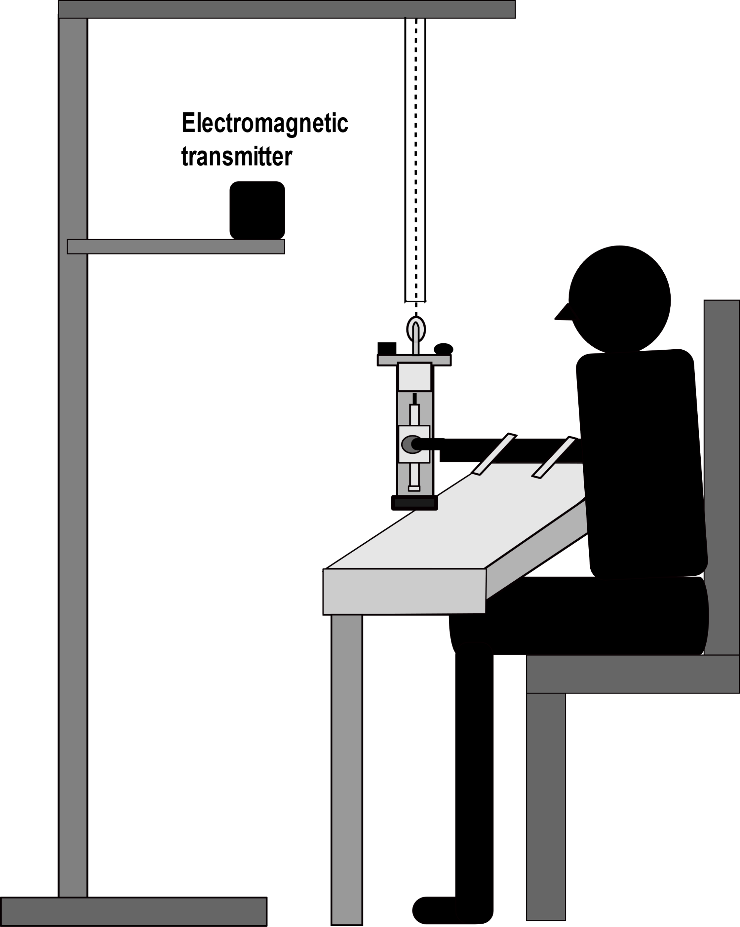
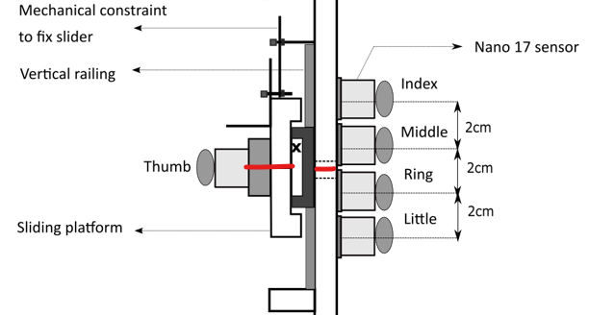
Experimental setup
Wooden support
CONDITIONS
Hollow PVC pipe
Nylon rope
Fixed
(30 trials)
One hour rest
Free
(30 trials)
Participant side of the handle frame
Thumb platform held at HOME position
Notes:
This is the experimental setup. The handle was suspended from the wooden support using a nylon rope housed within a hollow PVC pipe to restrict unwanted movement in the sideways.
The experiment consists of two conditions: Fixed and Free condition. In fixed condition, mechanical constraint was used to fix the position of the thumb platform steady at the HOME position. Whereas, during free condition, mechanical constraint would not be used to fix the thumb platform. During both the conditions, the task was to maintain the handle vertical without tilting towards any direction by matching the horizontal line on the platform to the line drawn midway between middle and ring fingers as shown in this picture. Throughout the trial, the participant had to ensure that the bubble is positioned at the center of the bull’s eye and horizontal lines on the handle was aligned.

Slide 9
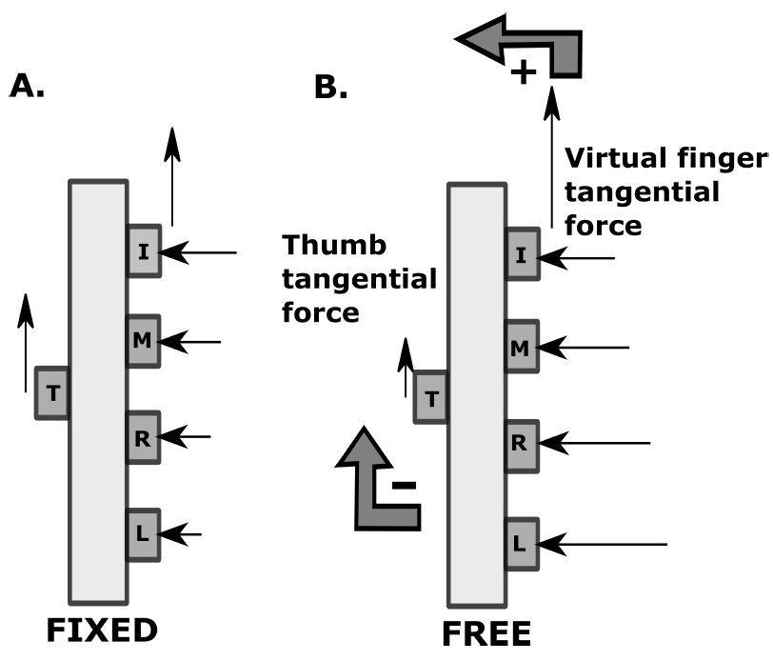
Experiment 1 - Results
Average Normal force
#
+ Pronation torque / anticlockwise
- Supination torque/ clockwise
Note
Radial fingers: Index and middle
Ulnar fingers: Ring and little
# statistically equivalent
Notes:
Now let me discuss the results of the first exp.
During free condition, thumb had to hold the slider platform of 100gm . Therefr tf produced by thumb would b 1n while remaining tf was shared by the other fingers. Due to the unequal tf distr between thumb and other fingers a pronation torque occurs (in antick direction. However the instructi wass to maintain the handle vertical (ie to maintain the static equilib.
The SUPINATION torque contributors are thumb TF and ulnar finger normal forces. Since the thumb TF is kept constant, it became the duty of ulnar fingers to produce compensatory supination torque. The ecpectation was MAH would be supported. In contrast the results were not as per the expectation. In this figure, we could see avg nf and tf produced by all fingers and thumb during both condition.
it was found that the normal force of the little finger was statistically comparable to the normal force of the ring finger during free condition. Thus the results on the nf was not supporting MAH hypothesis.

Slide 10
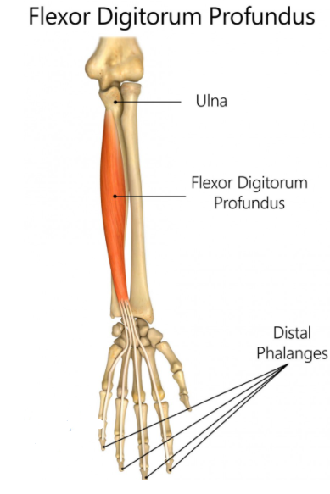
Conclusion from first experiment results
Reason 1: lesser mass of the handle
Reason 2: biomechanical constraint and neural interdependency
Reason
Biomechanical constraint
Neural interdependency
FDP: sole flexors of Distal Interphalangeal (DIP)
Joint of index to little.
Overlap in the motor units territories of the ring and little fingers at the medial portion of the FDP muscle which is responsible for the flexion of ulnar fingers.
Notes:
What could be the major reason for sharing comparable normal forces by the ulnar fingers?
The first suspicion was that it may be due to the lesser mass of the handle. Incase if the mass of the handle is greater, TF shared by IMRL fingers will be higher, then there might be a greater supination torque requirement, So there might be a chance for the little finger to produce greater nf than the ring finger.
Secondly, it might be due to the biomechanical constraints or neural interdependency. Biomechanical constraint include mechanical linkage that exist between the muscle compartments of the flexor digitorum profundus. That is, at the forearm level, the tendeons of middle ring and little fingers share a common muscle belly.
Next, at the palmar level, there is a tough fibrous sheet that interconnects the tendons of the middle, ring and little fingers. So this could be a reason for the restriction in the independent rise of the gripping force of little finger

Slide 11
Experiment 2 (Systematic mass increase study)
Research question
Will the mechanical advantage hypothesis be supported when the mass of the handle is systematically increased?
Notes:
Now let me start with he second experiment. From the results of the first experiment, following were the questions that popped up.
With the increase in the mass of the handle, supination torque requirement to retain the handle equilibrium also increases.
Therefore, the expectation was that MAH would be supported with an addition of external loads.

Slide 12
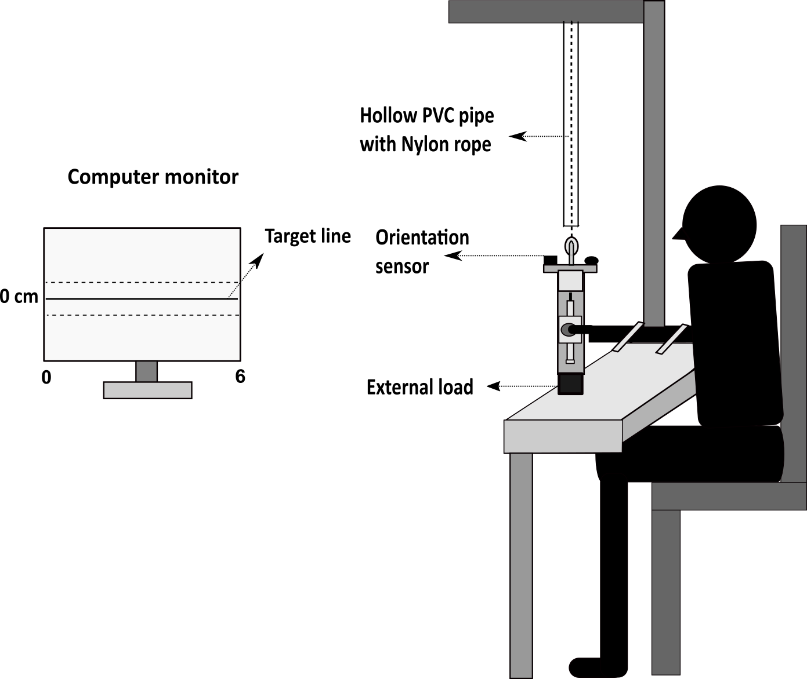
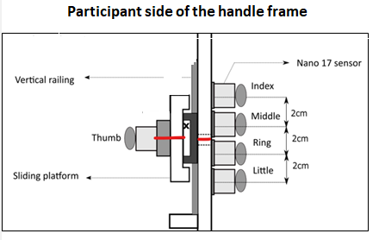
Experimental setup
CONDITIONS
Session 1
One hour rest
Session 2
0.150kg
(25 trials)
0.450kg
(25 trials)
30mins
30mins
0.350kg
(25 trials)
0.250kg
(25 trials)
Mass of the handle=450gm
Thumb position data
Notes:
This was exp setup of the second experiment. A similar kind of handle with few modifica was used for this study. Instead of a counterwet, provision was provided to attach external load of differn masses at the bottom of the handle.
For this experiment, computer monitor was kept in fron t of the particiap that dispalys solid horiz target line that corresponds to the HOME position. Thumb possitio was fed back as visual feedback line to trace the target line.
The task was to hold the handle in such a way by aligning the horizz line drawn on the center of the thumb platform to the line drawn between middle and ring fingers. So that the Thumb position data traces the solid line closely. Throughout the trail the handle had to be maintained in equilbr by aligning the lines and mainitain bubb at center of bull’s eye.
The exper was conducted as two separate session. In each session , there were two differ loads of different mass attached at the bott on handle. Each load corresponds to a condition. Sesion 1 consists of two condition of two loads and similarly seSesion 2 consists of two other condition of two other loads. For each loading condition 25trails were provide

Slide 13
Experiment 2 - Results
*
#
#
#
# statistically equivalent
* statistically different
Notes:
The expectation was that with the increase in the mass of handle, MAH would be supported. However the results were not as per the expection, It was found that during the addition of external loads such as 150g, 250g, 350g, MAH was not supported. However during the addition of external load of 0.450kg, little finger produced significantly greater NF than the ring finger. MAH was supported for a greater mass of 450gms comparaed tp the other loads. So this shows rhat it is nt merely due to mass of the suspended load.

Slide 14
Conclusion from second experiment results
It was suspected that it could be due to the challenge associated with the task could be the reason for supporting MAH.
Notes:
It was suspected that it could be due to the sense of challenge perceived during the task of maintaining static equilibrium of the handle with the addition of greater mass of 450gm was the reason for the little finger to produce greater nf than ring finger.

Slide 15
Experiment 3 (Uncomfortable grasp study)
Whether support for MAH depends on the challenge associated with the task?
Notes:
Next the third experiment. The question was to confirm whether the support for MAH depends on the challenge associated with the task

Slide 16
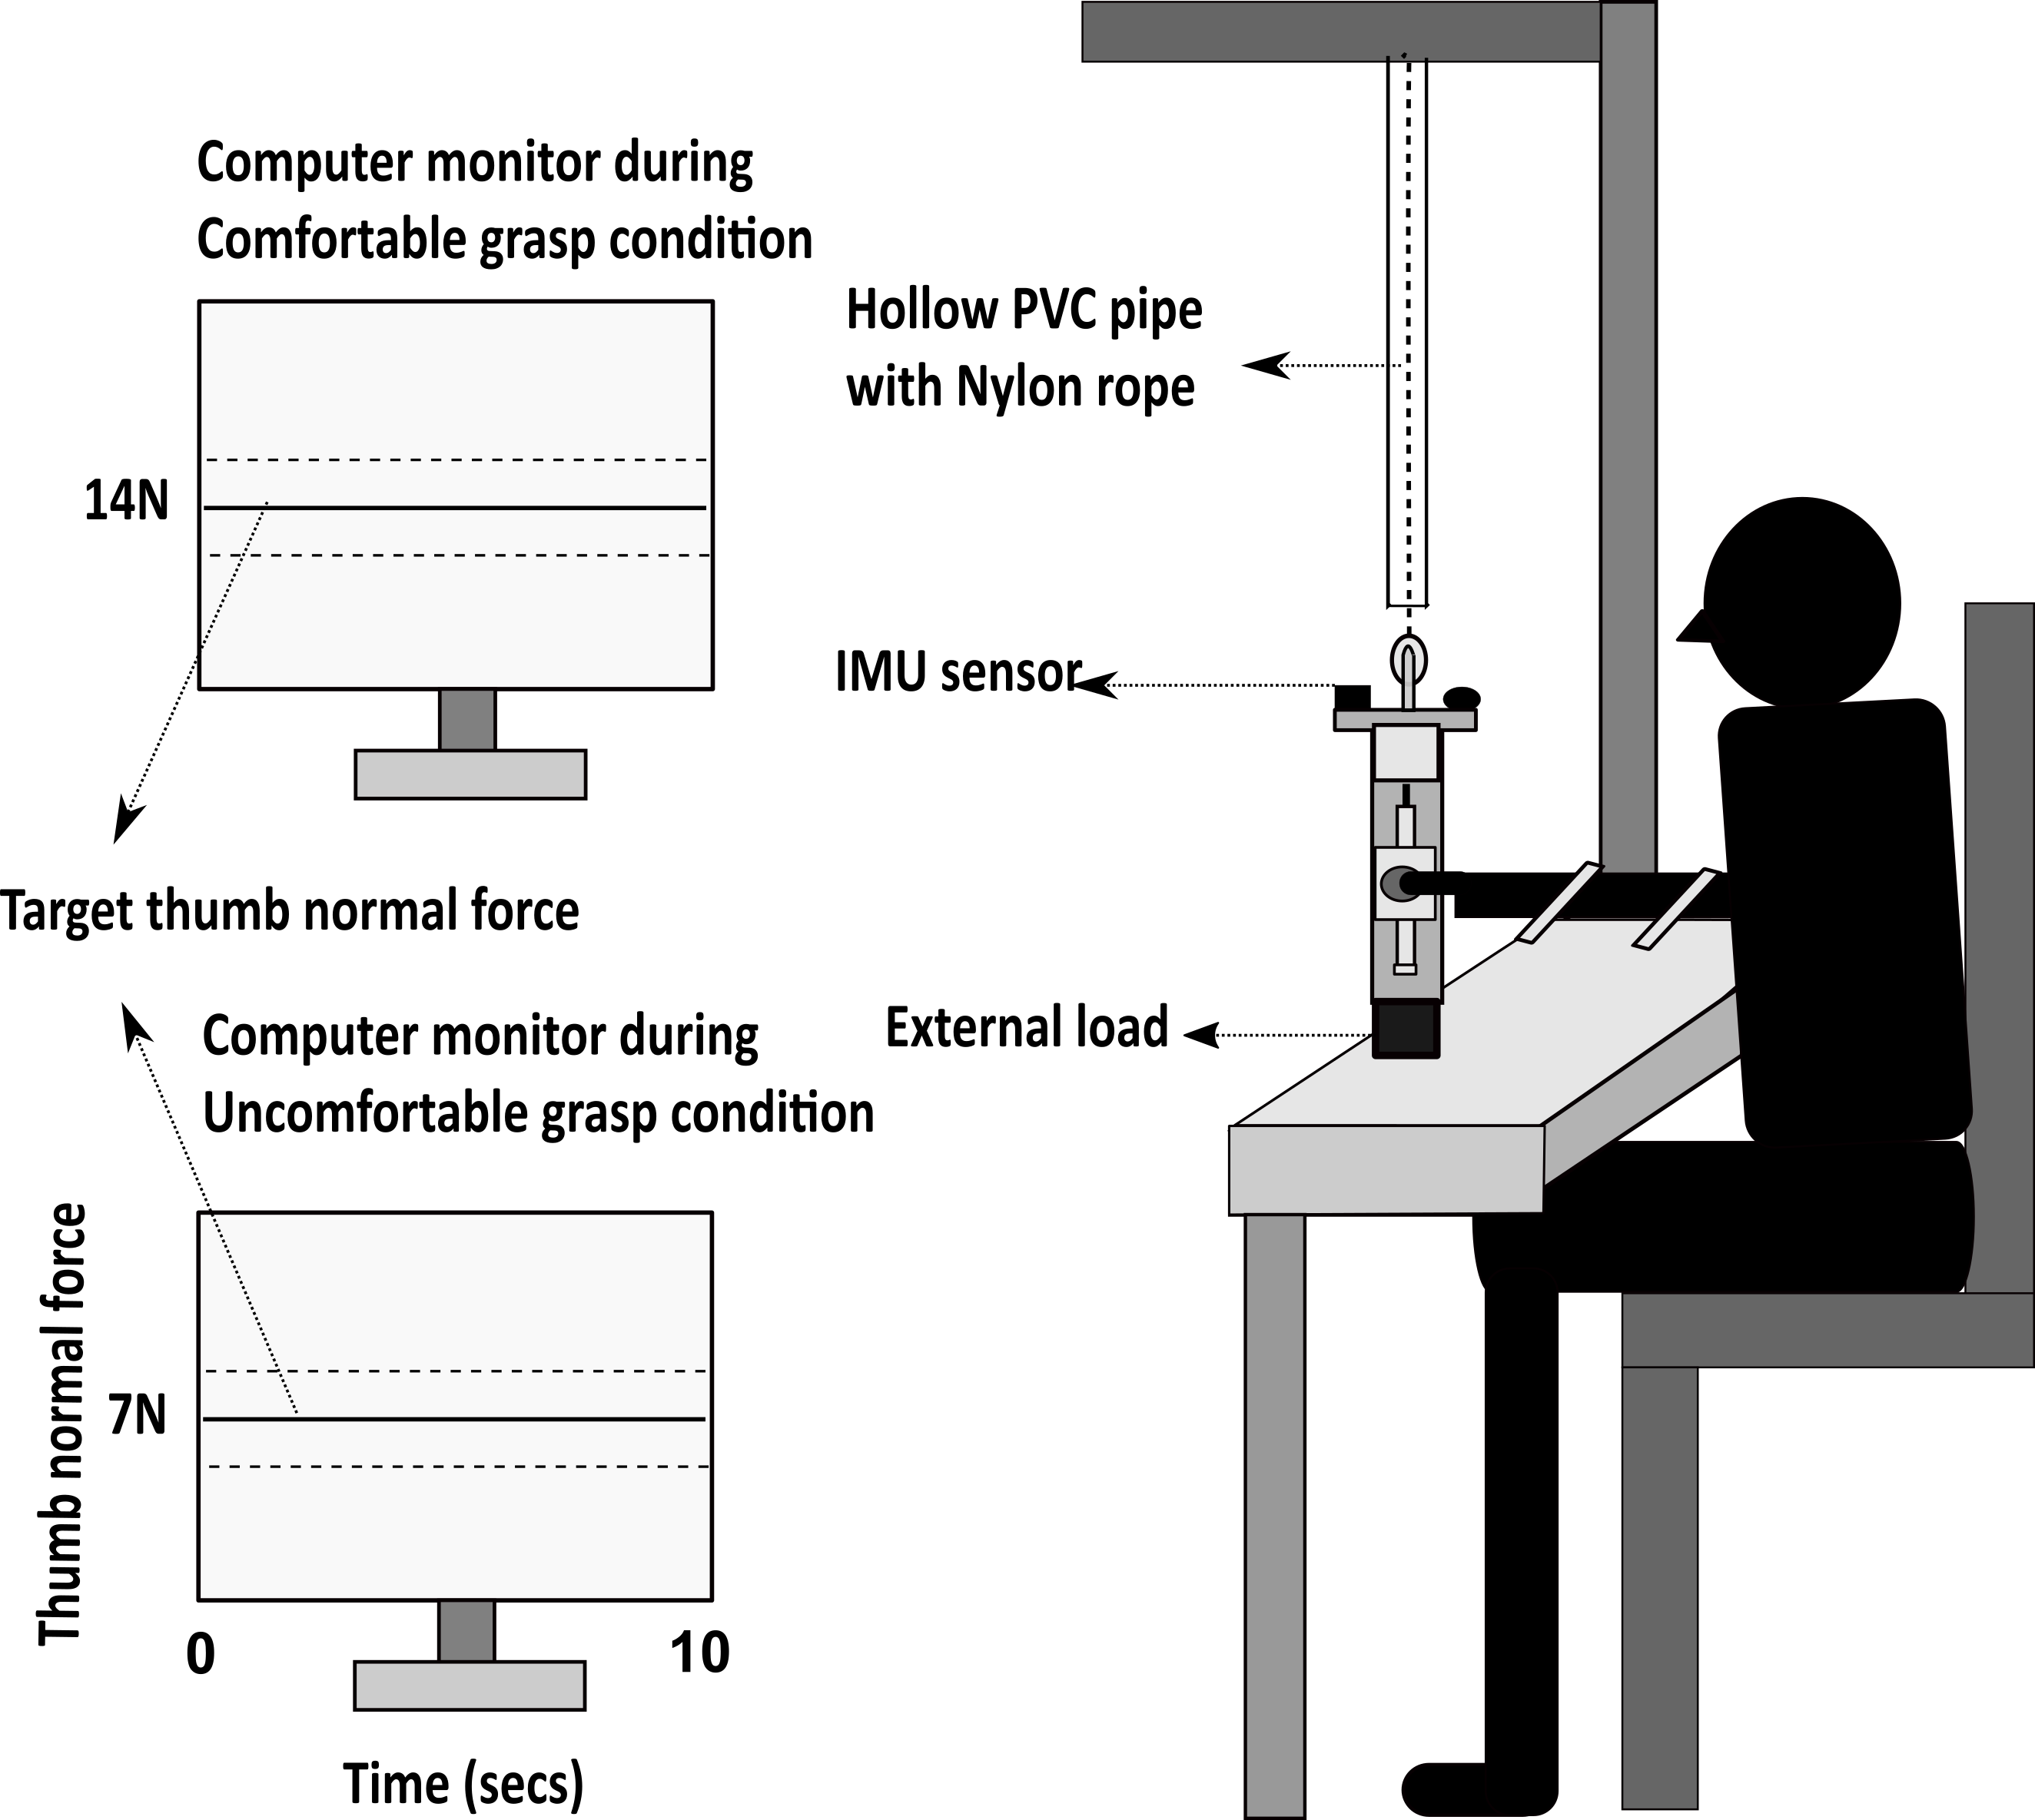
Experimental setup
CONDITIONS
Comfortable grasp
(25 trials)
Uncomfortablegrasp
(25 trials)
One hour rest
(0.250kg)
Mass of the handle including external load = 700gm
Thumb Normal force
Notes:
This is the experimental setup of the third experiment. Similar to the first and second experiment, the participants were holding the handle of mass 450gms with 250gms of load attached at the bottom of the handle. A computer monitor was kept in front of the participant that showed a solid horizontal target line for both conditions that corresponds to nf produced by thumb.
The experiment consists of two different conditions. One is Comfortable grasp and another is Uncomfortable grasp. In each condition, 25 trials were provided. Each trial lasted for 10seconds. Sufficient rest was provided between the conditions and trials.
During both the conditions, the task was to maintain the handle in static equilibrium by positioning the bubble at the center of bull’s eye and aligning the horizontal lines on the handle frame and platform. Most importantly, appropriate thumb nf had to be produced depending on the condition. So that the applied thumb nf would closely the trace the target line.

Slide 17
Experiment 3 - Results
#
*
# statistically equivalent
* statistically different
Notes:
As per the expectation, during uncomfortable grasp condition, little finger produced greater normal force than the ring finger, wherea during comfortable grasp condition, ulnar fingers exerted a comparable normal force.

Slide 18
Conclusion from third experiment results
During uncomfortable grasp condition,
Constraint on thumb position- Thumb was restricted to be placed at HOME position
Constraint on handle design- Thumb tangential force restricted
Task constraint- Thumb normal force restricted to minimal normal force of 7N
It was confirmed that the difficulty associated with the task could be reason for MAH to be supported.
Notes:
The reason for supporting MAH during uncomfortable grasp condition is that, there were three different constraints to be taken care while perforing the object stabilization task.
One is restriction imposed on the handle design which was common in all studies ie restr in the thumb TF by mounting it over a slider platform, then the task restriction and then the restriction imposed on the thumb position.
Although the ulnar fingers showed a comparable results for a handle of mass 700gms during simple grasp condition, for the same handle mass, ulnar fingers exerted significan different nf during the weak grasp condition. Thus this shows that , the sense of challenge that was perceived due to the restriction imposed on the thumb nf had caused MAH to be supported.
In case if the ulnar fingers exert comparable force during weak grasp condition, then it may cause strain in the flexor muscles of both the ring and little fingers,, which may lead to the fatigue of the ulnar fingers . Thus to avoid this, CNS has decided to minimize the total effort especially the normal force produced by the ring fingers without compromising to produce required magnitude of supination torque by the ulnar fingers. Therfore CNS had preferred to make use of the mechanica;l advantage of the little finger. Thus by producing greater nf by the little finger than the ring finger.

Slide 19
Experiment 4 (Pattern tracing study)
How do the peripheral fingers contribute to re-establish static equilibrium when there are torque changes introduced due to vertical translation of the thumb?
Notes:
Finally there comes the fourth experiment. It was known from the literature that the peripheral fingers (index and little) play an imp role in retaining back the static equilibrium of the handle when there was perturbation caused to the handle due to the torque changes. So the next obvious question was, how do the peripheral fingers contribute to re-establish the equilibrium when there were torque changes induced due to translation of the unsteady thumb platform in the vertical direction towards the index and little finger side.

Slide 20
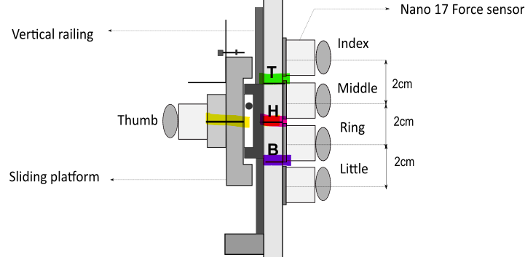
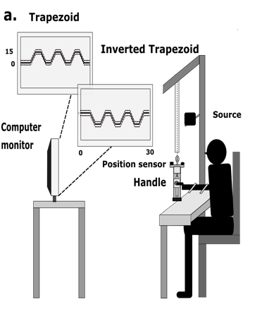
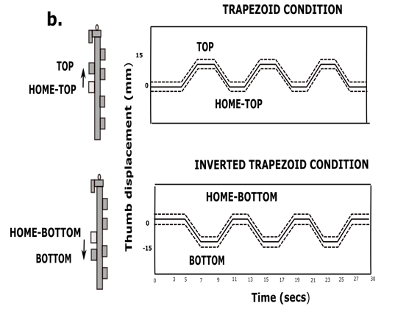
Experimental setup and handle
T- Top, H-Home, B-Bottom
Up-ramp
Down-ramp
Feedback line = Thumb
platform
position data
Notes:
In order to investigate this question, ,The same handle that was used for the first experiment was used. But, For this study, 3 horizontal lines were drawn on the handle frame, indicated using the letters T,H,B. H represents the HOME position (ie found midline between middle and ring fingers. T represents TOP position (i.e found 1.5cm up from the HOME position. B represents Bottom position (i.e found 1.5cm down from HOME) .
This is the experimental setup where the participant sits in front of the computer monitor by holding the handle.
There will be two conditions: trapezoid or inverted trapezoid. In each condition, there will be 12 trials. Each trial will have 3 patterns arranged sequentially.
During both conditions, the task was to trace the pattern displayed on the computer monitor by translating the thumb platform in the vertical direction. The thumb displac data was fed as a visual feedback line to trace the pattern displayed on the monitor. During trapezoid condition, initially the thumb platform had to be held steady for 3s at HOME, then slowly the platform had to be moved 1.5cm up which involves tracing the up ramp of the trapezoid. This will then be followed by tracing the static portion found at the end of the up ramps said to be called as TOP. Then The thumb platform had to be slowly moved down to HOME tracing the down ramp of the trapezoid pattern. In this way by moving the platform to and fro sequentially would result in the completeion of a trial
In the case of inverted trapezoid condition, the slider had to be translated 1.5CM down from HOME to BOTTOM static portion and then staying at BOTTOM for 2 sec which will then followed by moving the platfor up to the HOME posi. In this way, next consecutive inverted trapezoid patterns had to be traced. Throughout the trial, the subject had to maintain the handle in static equilib by maintaining the buble at the center of bull’s eye without tilting

Slide 21
Experiment 4 - Results
Change in the normal force
Change in the normal force of index finger (during upward translation)
vs Change in the normal force of the little finger (during downward translation)
Trapezoid condition
Inverted
Trapezoid condition
TOP
T
I
1.5cm
Home
Home
1.5cm
BOTTOM
T
L
Notes:
Average normal and tangentioal forces of indi fingers and thumb were computed only for the static portions TOP, HOME-TOP, HOME-BOTTOM, BOTTOM.

Slide 22
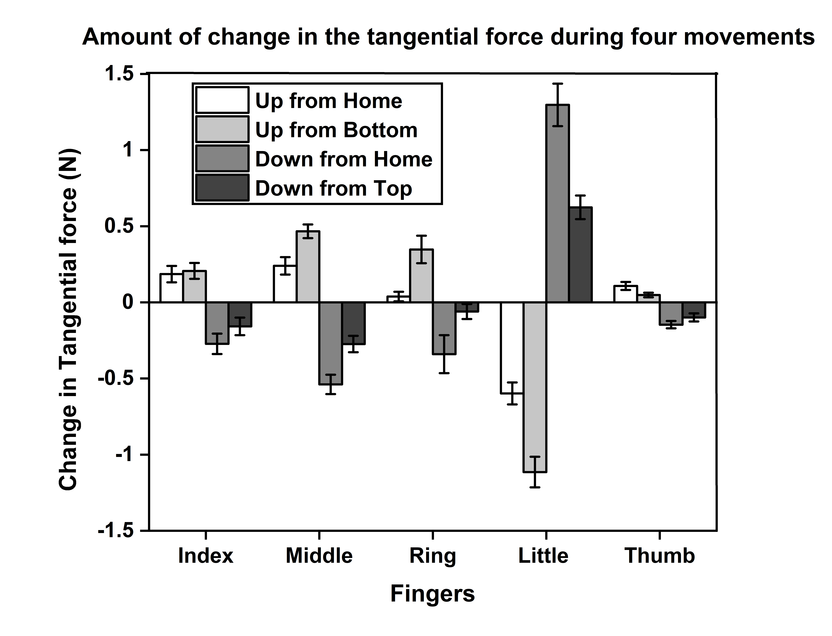
Change in the tangential force

Slide 23
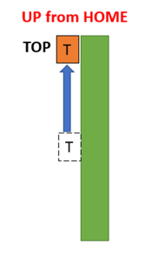
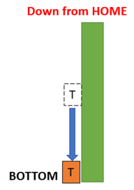
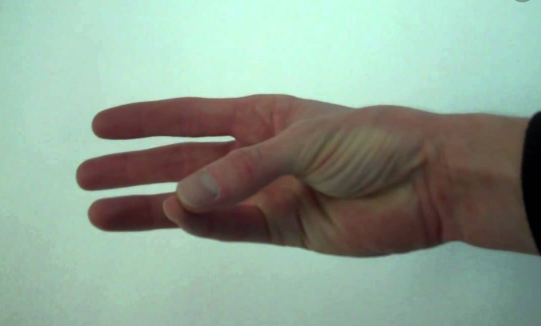
Conclusion from fourth experiment results
Radial abduction or extension of CMC joint of thumb
T
Abduction of little finger
T
L
Opposition of little finger
Opposition or Flexion of CMC joint of thumb
T
T
L
CMC- Carpometacarpal joint
Notes:
The reason for the little finger to decrease and increa its tangential force during the upward and downward translation of the thumb may be explained from a biomechanics perspective. The upward movement of the thumb while holding an object is considered as an extension movement or radial abduction of the CMC joint of the thumb.
Abduction of the little finger was indirectly noticeable from the decrease in the little finger tangential force

Slide 24
Major Contributions
Role of ulnar fingers in establishing static equilibrium was studied (Experiment 1)
Published article: Comparable Behaviour of Ring and Little Fingers Due to an Artificial Reduction in Thumb Contribution to Hold Objects, in PeerJ, Banuvathy Rajakumar and Varadhan Skm, 2020, doi: 10.7717/peerj.9962, 8:e9962, Open-Access- Yes, Indexed by- Scopus, WOS.
Published book chapter: Comparable Safety Margins of the Ulnar Fingers When the Thumb Remains on an Unsteady Slider, in Recent Advances in Applied Mechanics (eds. Tadepalli, T. & Narayanamurthy, V.) 261–274 (Springer, 2022), Rajakumar, B. & Varadhan, S. K. M. doi:10.1007/978-981-16-9539-1_19. (SCOPUS indexed)
At what situation the strategy of MAH was adopted by CNS was confirmed (Experiment 2 and 3)
Accepted for publication: Validity of Mechanical advantage hypothesis of human grasping depends on the nature of task difficulty, Banuvathy Rajakumar, Swarnab Dutta and Varadhan SKM- submitted in Scientific Reports, Nature publishing group, Open-Access- Yes, Indexed by- Scopus, WOS.
Submitted for review: Evidence to support the mechanical advantage hypothesis of grasping at low force levels, Banuvathy Rajakumar and Varadhan SKM- submitted in Scientific Reports- currently under review, Nature publishing group, Open-Access- Yes, Indexed by- Scopus, WOS.
Notes:
From the results of the first experiment, which was conducted as a preliminary study, the contribution of the ulnar fingers for establishing equilibrium was examined when the thumb was placed on an unsteady platform. Studies from literature introduced perturbation in the form of external torque changes. However in the current research torque changes were induced by using an unsteady thumb platform. The results of this study helped to ask if the support for MAH depends on magnitude of Mass or supination torq requirem
Next is, generally from literature, it was a common question to understand what strategy cns employs in achieving the goal of any task. However, In this particular research, inaddition to the strategy employed , at wat situation particular strategy was followed by cns was investigatedd.
Thirdly, By means of pattern tracing study, Continuous assessment of flexion and extension forces of the thumb was done. There are devices available to measure flexion and extension forces of fingers, flexion of thumb. However there were no device to measure the extension force of the thumb.
Lastly, from the same pattern tracing study, distinct behave off the litt finger was seen when the thumb was translating in the vertical direction. It was found that there exist a biomechanical relationship between thumb and little finger which was revealed thrpugh the fingertip forces.
Through this research work, from the results of second and third experiments, it was confirmed that the sense of challenge perceived during the task performance was the reason for CNS to utilize mechanical advantage of the little finger
(Damage to the neuronal connections is common in the brain of post-stroke patients. It results in the inactivation of the specific finger or hand muscles corresponding to damaged connections. Strengthening exercises are a great way to form new neuronal connections in the brain to re-activate such fingers and hands. Repeating the same task several times helps the brain to form new connections, to re-learn, and recover faster. Although there are several devices like Digi flex, soft foam balls, and dynamometers are available in the market for improving the overall grip strength, quantitative assessment of the individual finger strength, especially ulnar fingers (ring and little), is not available.)
In patients with Ulnar nerve injuries, litle finger abduction and adduction were impossible

Slide 25
Major Contributions
Continuous assessment of flexion and extension forces of the thumb (Experiment 4)
Accepted for publication: Dataset of fingertip forces while grasping a handle with unsteady thumb platform- Rajakumar Banuvathy and SKM Varadhan- data descriptor submitted in Scientific data, Nature publishing group, Open-Access- Yes, Indexed by- Scopus, WOS.
4) Distinct behavior of little finger was observed when the thumb was translating in the vertical direction while grasping. Thus the biomechanical relationship between thumb and little finger was identified from the fingertip forces. (Experiment 4)
Published article: Distinct Behavior of the Little Finger during the Vertical Translation of an Unsteady Thumb Platform While Grasping, in Scientific Reports, Rajakumar Banuvathy and SKM Varadhan, 2021, doi: 10.1038/s41598-021-00420-5, 11(1):21064, Nature publishing group, Open-Access- Yes, Indexed by- Scopus, WOS.
Notes:
From the results of the first experiment, which was conducted as a preliminary study, the contribution of the ulnar fingers for establishing equilibrium was examined when the thumb was placed on an unsteady platform. Studies from literature introduced perturbation in the form of external torque changes. However in the current research torque changes were induced by using an unsteady thumb platform.
Next is, generally from literature, it was a common question to understand what strategy cns employs in achieving the goal of any task. However, In this particular research, inaddition to the strategy employed , at wat situation particular strategy was followed by cns was investigatedd.
Thirdly, By means of pattern tracing study, Continuous assessment of flexion and extension forces of the thumb was done. There are devices available to measure flexion and extension forces of fingers, flexion of thumb. However there were no device to measure the extension force of the thumb.
Lastly, from the same pattern tracing study, distinct behave off the litt finger was seen when the thumb was translating in the vertical direction. It was found that there exist a biomechanical relationship between thumb and little finger which was revealed thrpugh the fingertip forces.
Through this research work, from the results of second and third experiments, it was confirmed that the sense of challenge perceived during the task performance was the reason for CNS to utilize mechanical advantage of the little finger
(Damage to the neuronal connections is common in the brain of post-stroke patients. It results in the inactivation of the specific finger or hand muscles corresponding to damaged connections. Strengthening exercises are a great way to form new neuronal connections in the brain to re-activate such fingers and hands. Repeating the same task several times helps the brain to form new connections, to re-learn, and recover faster. Although there are several devices like Digi flex, soft foam balls, and dynamometers are available in the market for improving the overall grip strength, quantitative assessment of the individual finger strength, especially ulnar fingers (ring and little), is not available.)
In patients with Ulnar nerve injuries, litle finger abduction and adduction were impossible

Slide 26
References
Niu, X., Latash, M. & Zatsiorsky, V. Effects of Grasping Force Magnitude on the Coordination of Digit Forces in Multi-finger Prehension. Experimental brain research. Experimentelle Hirnforschung. Expérimentation cérébrale 194, 115–29 (2009).
Zatsiorsky, V. M., Gregory, R. W. & Latash, M. L. Force and torque production in static multifinger prehension: biomechanics and control. I. Biomechanics. Biological Cybernetics 87, 50–57 (2002).
Zatsiorsky, V. M., Gregory, R. W. & Latash, M. L. Force and torque production in static multifinger prehension: biomechanics and control. I. Biomechanics. Biol Cybern 87, 50 (2002).
Slota, G. P., Latash, M. L. & Zatsiorsky, V. M. Tangential Finger Forces Use Mechanical Advantage during Static Grasping. Journal of Applied Biomechanics 28, 78–84 (2012).
Solnik, S., Zatsiorsky, V. M. & Latash, M. L. Internal Forces during Static Prehension: Effects of Age and Grasp Configuration. J Mot Behav 46, 211–222 (2014).

Slide 27
Thank you

